Slide 1
2021 PK Guide
August 30, 2021

Slide 2
Kitchen Sink Suite Installation Guide

Slide 3
Kitchen Sink Suite Installation Guide
The concept of the Kitchen Sink Suite is for Mountain to be the GO TO LINE for kitchen accessories.
We are expanding beyond just telling people about the products functionality…we want to demonstrate how the products can upgrade and elevate the customer’s entire experience when using and cooking in the kitchen.
This is the key on how to talk to customers about the kitchen accessories being an actual design choice and not just a utilitarian choice

Slide 4
2020 Marketing Direction
Words, from Bruce…
Use this link if next slide will not play
https://youtu.be/SYf0rZOcinE

Slide 5
2020 Marketing Direction

Slide 6
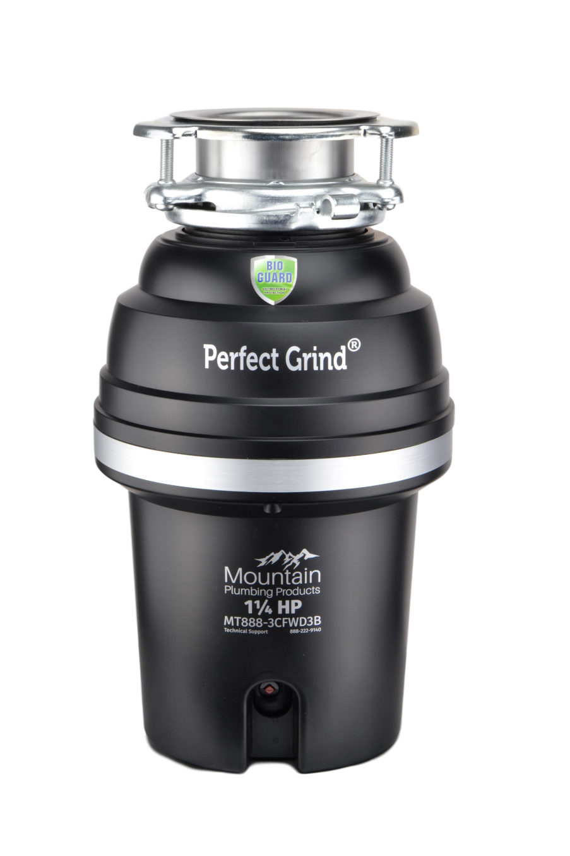
Perfect Grind Waste Disposers
All showroom models have LIFETIME warranty!
⅝ hp
¾ hp
1-¼ hp
Not sold in Big Box retail!

Slide 8
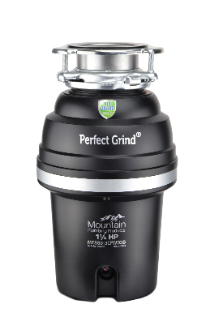
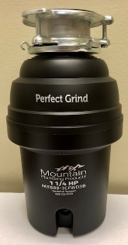
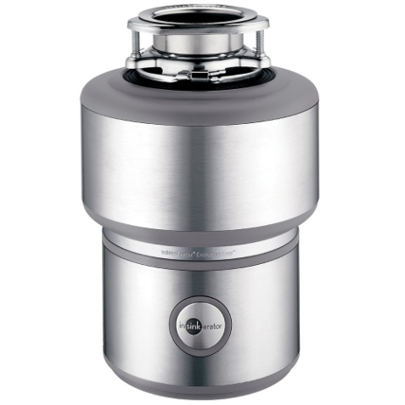
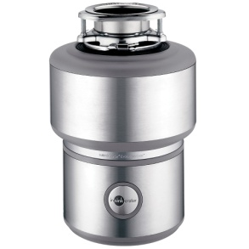
Smaller and Lighter
LIGHTER
SHORTER
9”
7 ⅝”
14 ⅛”
13 ½”
13 lbs!!!
25.5 lbs!!!

Slide 9
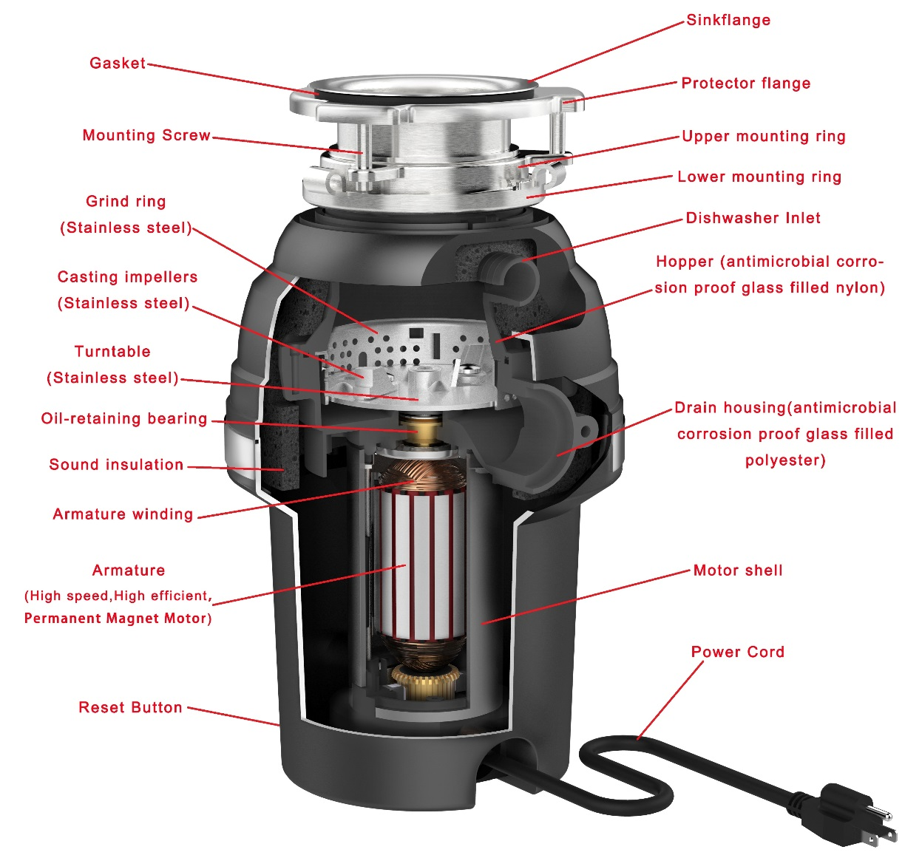
Perfect Grind Waste Disposers
Inner Workings:

Slide 10
Speed and Performance
Mountain Perfect Grind disposers are 30% faster (2500 RPM) than the ISE Induction (1725 RPM) units.
Motor Speed + Design of Chamber = FASTER GRINDING
This means the consumer finished the job much faster and spends less time over the sink.
Can be safely used with a septic system.

Slide 11
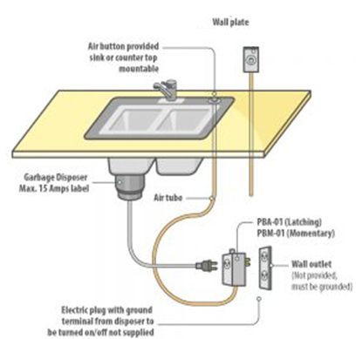
Kitchen Sink Accessories
Air Switches
Safety – Eliminate the risk of electrical shock
Perfect for island sink installations

Slide 12
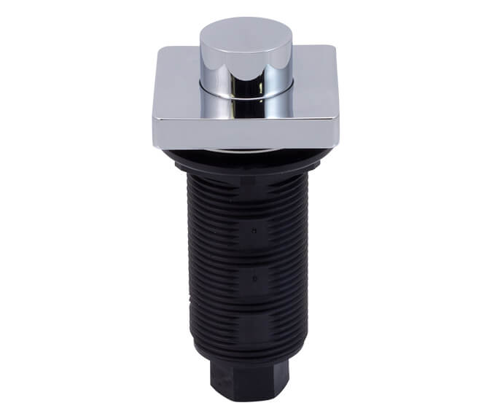
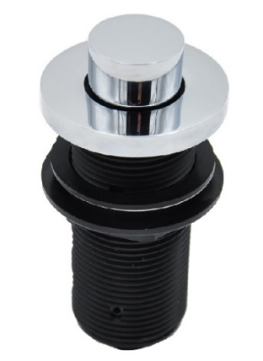
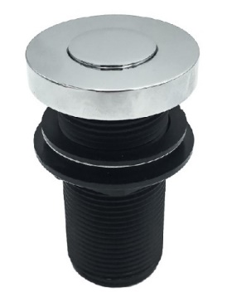
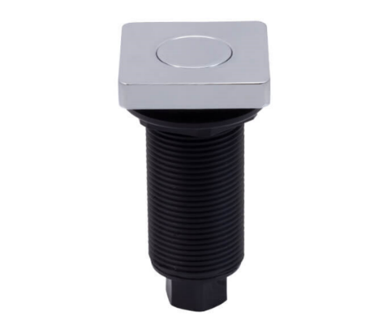
Kitchen Sink Accessories
Deluxe Air Switches
Solid Brass Button & Flange
Longer Threaded Shank
MT964K
MT964T
MT962R
NOTE: Some manufacturers do not offer air switches: i.e. Kohler, DXV, Grohe, Hansgrohe, Delta, Brizo
MT957
MT957R
MT962

Slide 13
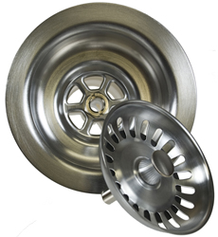
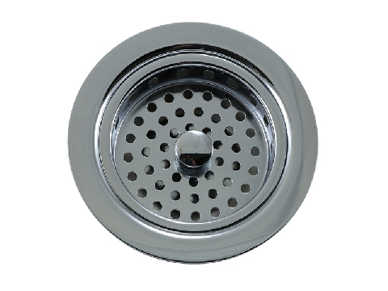
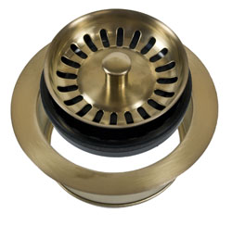
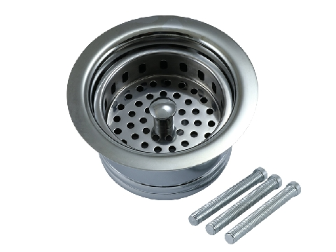
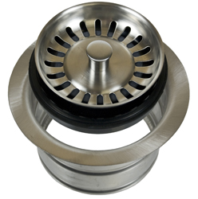
Kitchen Sink Accessories
Sink Strainers & Matching Disposer Flanges
Traditional
Duo Strainer
Classic
MT300
MT8799
Sink
Sink
MT200EV
Disposer
Extended flange
3 bolts included to used when installing on thinner sinks
MT7799EV
Extended flange
Disposer
MT202
Disposer

Slide 14
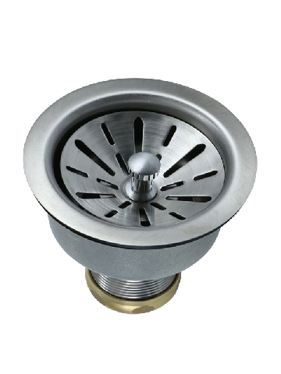
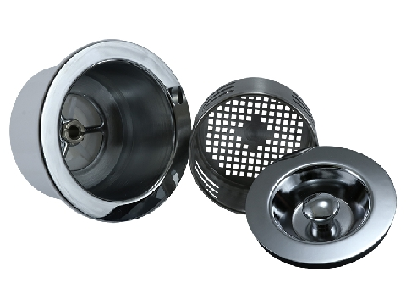
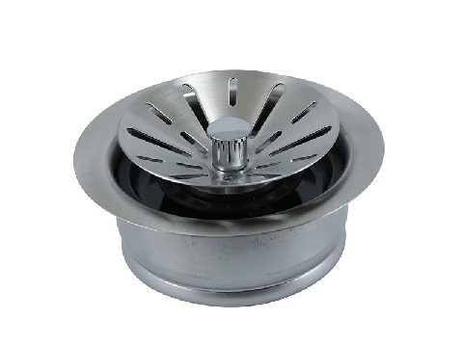
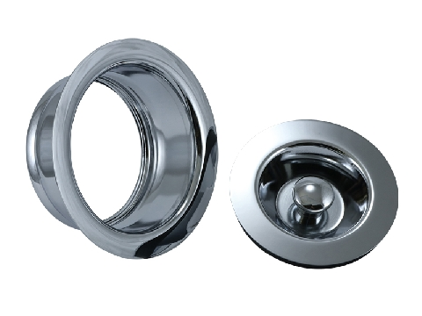
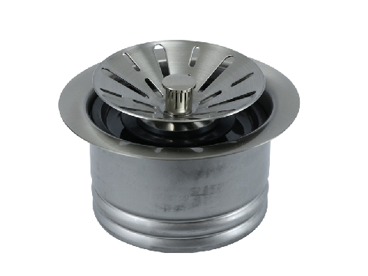
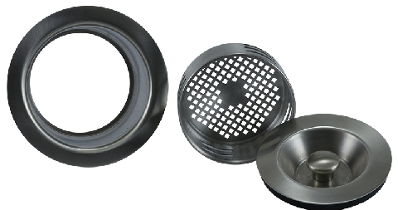
Kitchen Sink Accessories
Sink Strainers & Matching Disposer Flanges
Contemporary
3-in-1
MT310
MT115
Sink
Sink
MT120EV
Disposer
Removable basket NOT included
MT210EV
Disposer
Extended flange
3 bolts included to used when installing on thinner sinks
Includes removable basket
Extended flange
MT212EV
Disposer
MT130
Disposer

Slide 15
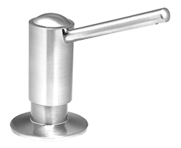
Kitchen Sink Accessories
Soap / Lotion Dispensers
Larger 16 oz reservoir bottle vs competitors 12 oz
All units easily refill from above the countertop
Lifetime warranty on all pumps

Slide 16
Water Appliances
Little Gourmet Premium Hot Water System
Reverse Osmosis Compatible
190°+ Instantly
1300w Power
Energy Efficient – Uses less energy than a 40w light bulb
5/8 Gallon Tank Size
3 Year Warranty
MT641-3

Slide 17
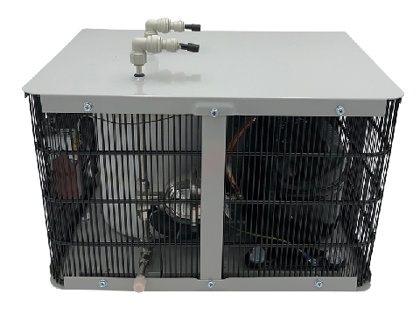
Water Appliances
Mountain Chill Water Chiller
39° to 50° Water Instantly
1.5 Gallons per Hour
1/2 Gallon Tank Size
3 Year Warranty
MT670-2

Slide 18
Water Appliances
Mountain Pure Water Filtration
The case for the need of water filtration has been made. Homeowners regularly drink bottled water or ‘filtered’ water from the refrigerator.
Instances of LEAD found in potable water due to governmental negligence has grabbed headlines…
Flint, MI
Newark, NJ
Baltimore, MD
Chicago, IL
Milwaukee, WI

Slide 19
Water Appliances
LEAD
Homes built prior to 1986 may have 20% or more lead in their plumbing system
Lead can be found in newer homes as well…until June 2014, the legal limit for “lead-free” pipes was up to 8%
Source: EPA Website
Notes:
EPA website

Slide 20
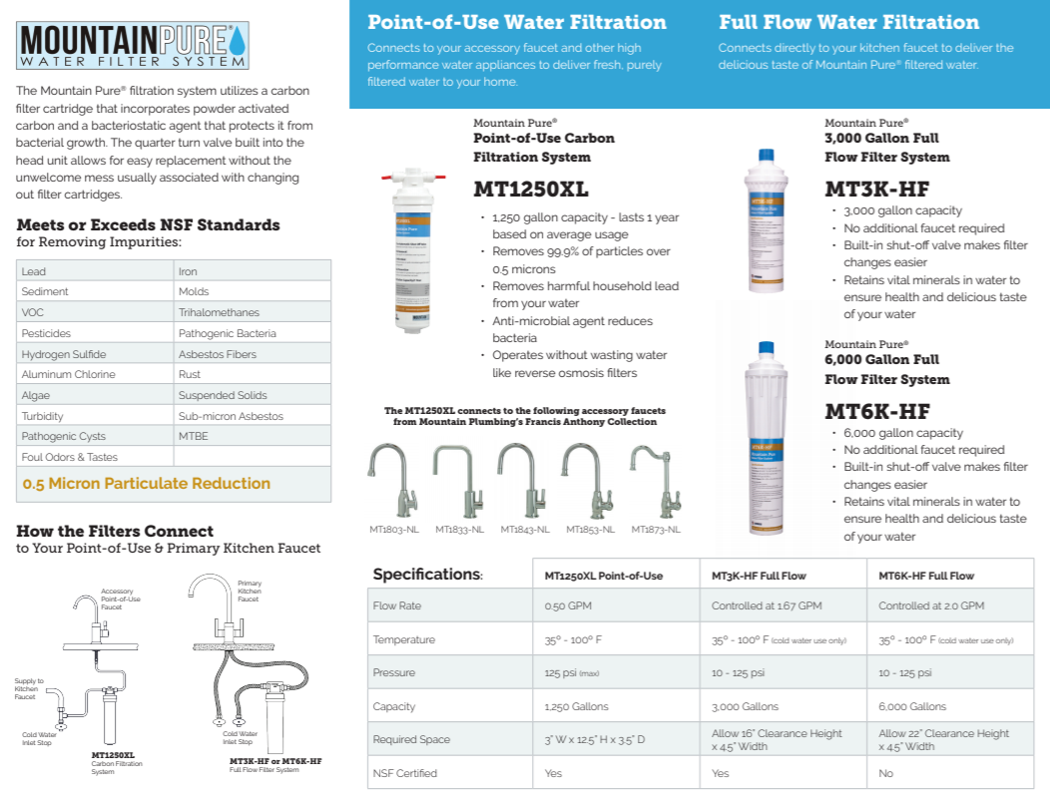
Water Appliances
39° to 50° Water Instantly
1.5 Gallons per Hour
1/2 Gallon Tank Size
3 Year Warranty

Slide 21
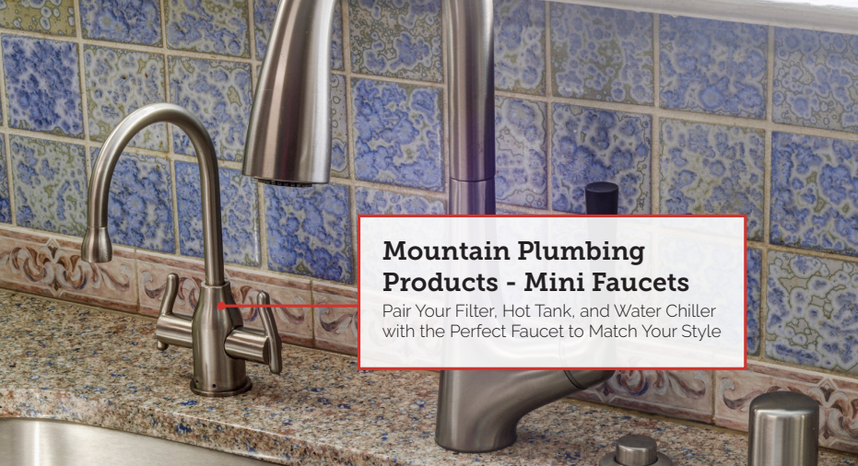
Water Appliances

Slide 22
Water Appliances
The Francis Anthony Collection of Point of Use and Instant Hot Faucets are among the smallest available. Utilizing a mini cartridge designed in Europe, the Francis Anthony faucets are not just shorter, but maintain their proportions throughout the entire faucet
MT1800
MT1820
MT1830
MT1840
MT1850
MT1870
MT1880

Slide 23
Industrial Lever Handle
Available in the following faucet series:
MT1820
MT1830
MT1840

Slide 24
Knurling
Knurled Accents
Intricate diamond knurling adds richness and depth to the design of your faucet. Knurling accents are becoming more common in modern classic environments and urban industrial spaces.

Slide 25
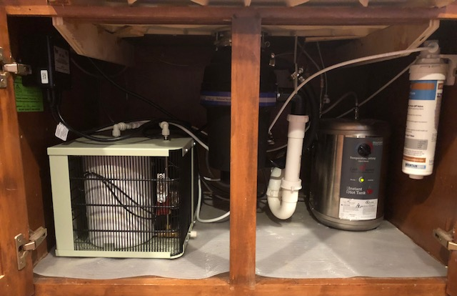
Under Cabinet Peek

Slide 26
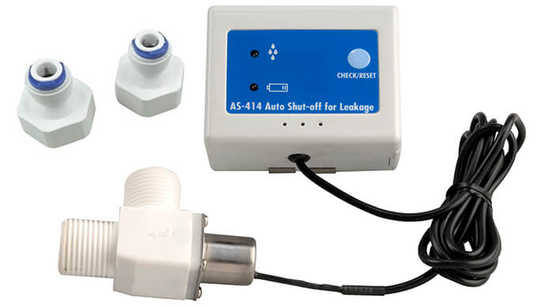
Water Appliances
Safety Valve - Leak Detector
Automatically shuts off once water is detected
Audio alarm when leak occurs
Operates on 9V battery
Quick connect 1/4″ adaptor included for easy installations
Use with Mountain Plumbing Little Gourmet hot tank and/or Mountain Pure filtration unit

Slide 27
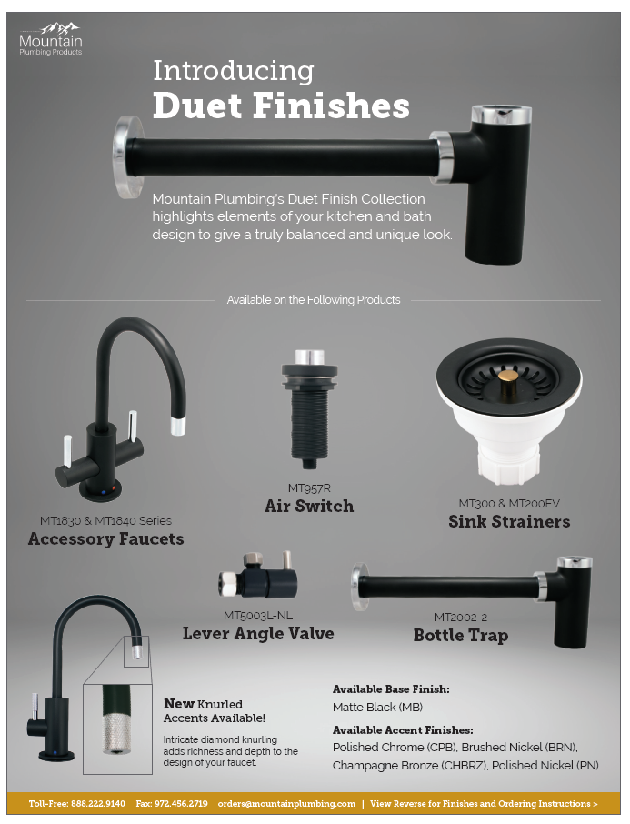
Duet Finishes
Mountain Plumbing’s Duet Finish Collection highlights elements of your kitchen and bath design to give a truly balanced and unique look. This product has a more modern style, yet can match with many designs.
Duet Finish Combinations
Combining the modern Matte Black finish with four complimentary colors, specific details of each part stand out. These products give a truly balanced look and a touch of flair to an often forgotten element of designing a kitchen or bath.

Slide 28
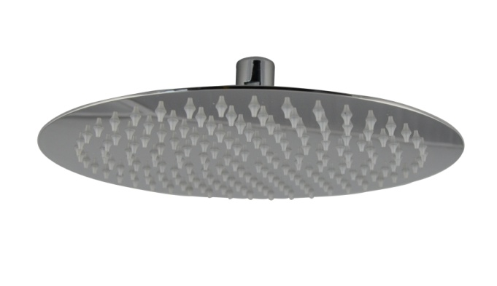
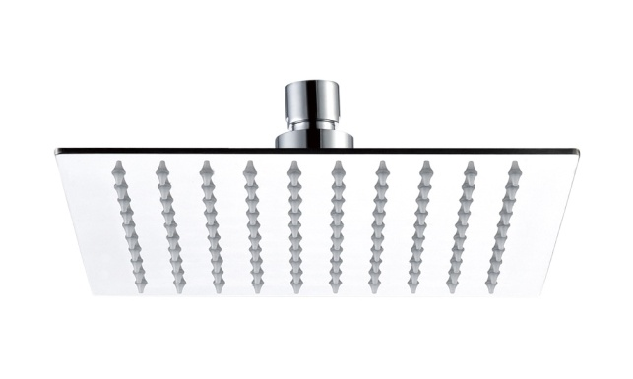
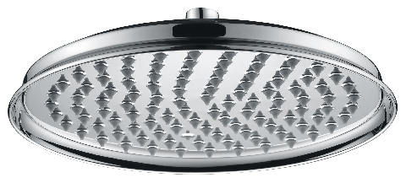
Re-Vive Collection – Rain Heads
3 Styles
Round (6”,8”,10”,12, 16”)
Square (6”,8”,10”,12”, 16”)
Traditional (8” & 10”)
Ultra Slim Design, Less Than 3mm
Stainless Steel
Seamless Construction
Clog Free nozzles
1.6 GPM Standard w/ 2.5 GPM Restrictor Included
*Finishes: CPB, BRN, PN, ORB, MB, VB

Slide 29
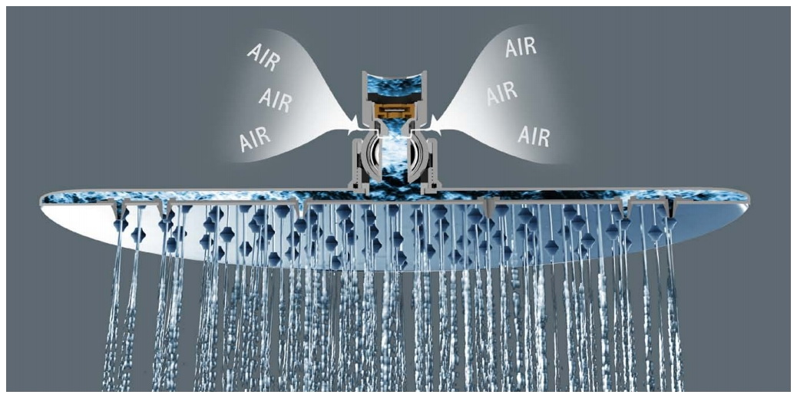
Air Injected Rain Heads
Air injected rain heads
Firmer and more encompassing spray
Only available in 6”, 8” and 10”
Available in Round, Square and Traditional
Available in CPB, BRN, PN, MB, ORB, CHBRZ
$30 List premium over regular heads
Notes:
We now have something to complete with Jaclo and other air injected heads

Slide 30
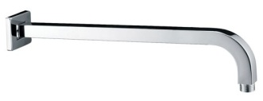
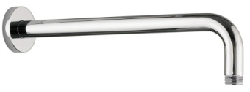
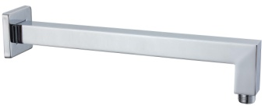
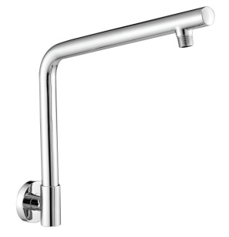
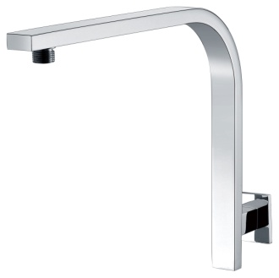
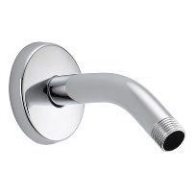
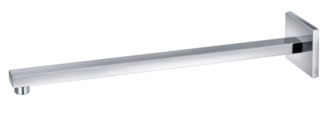
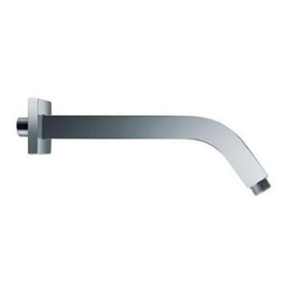
Re-Vive Collection – Accessories
Arms
Hand Showers

Slide 31
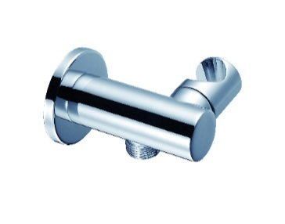
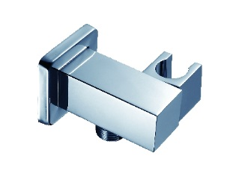
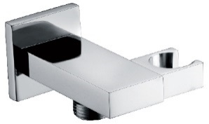
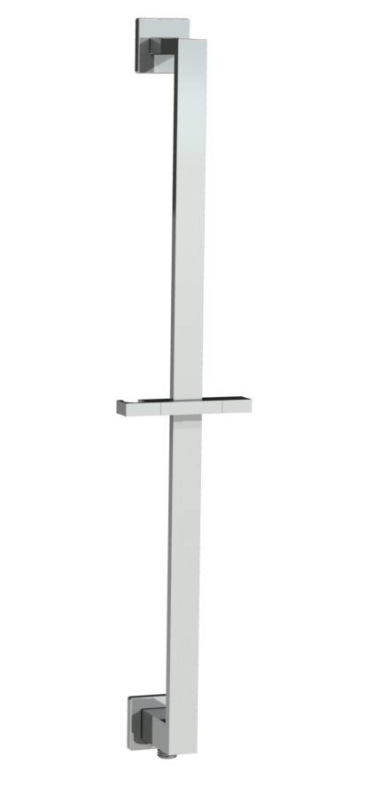
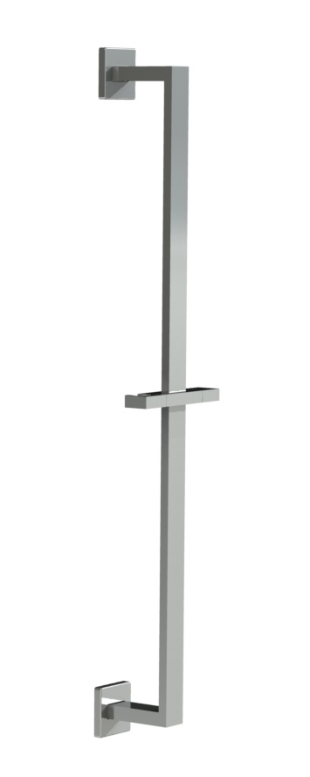
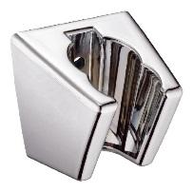
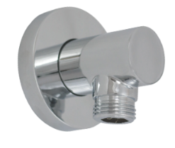
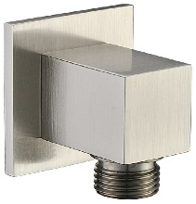
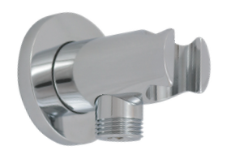
Re-Vive Collection – Accessories
Slide Rails
Hand Shower Holders
With Integral Waterway
Slide Rail Only
Hand Shower Hose
MT8SRW
MT9SRW
MT9SR
MT8SR

Slide 32
Re-Vive Collection – Rain Rail Plus
Rain Rail Plus
Perfect for retrofit remodel
No need to break into wall
Ties into existing shower arm outlet and anchors over tile
cUPC approved
Components sold individually
i.e. shower head, hose, hand shower

Slide 33
Re-Vive Collection – Rain Rail Plus
Introducing new size – 18”
MTRRP-18/***
2-way divertor for California
Now includes angled hose connector
25”
Or
18”

Slide 34
Select Series Shower Drains
Trim Options
Drain Neck Assembly
Plastic Construction
‘Vanishing’ Thin Edge Design
Includes Hair Catcher & Debris Cover
MT607
MT606
4” Square
3/16” Thick 304 Stainless Steel
Includes Grid Removal Tool
Schluter Adaptor
MT608
Plastic Construction
Allows For Installation into Fabric Water Proofing Systems; i.e. Schluter-KERDI
Tile-in
3-1/2” Square Grid
Plastic Construction
Includes Grid Removal Tool
MT603A
MT609

Slide 35
Bathroom Accessories
Valves
Selecting the Correct Stop
¼ Turn Ball or ¼ Turn Ceramic Cartridge
Angle or Straight
(Inlet) - Compression or IPS or Sweat
X
3/8” O.D. Compression (Outlet)

Slide 36
New Valve Design
Lever Handle Ball Valve
MT521-NL
Only available in Angle Compression
Mini Lever Handle with 1/4 Turn Ball Valve
1/2″ Compression (5/8″ O.D.) Inlet
3/8″ O.D. Compression Outlet
Lead Free

Slide 37
Bathroom Accessories
Cover Sleeve
Available in 12” & 20”
Ability to be cut down to fit 16” lines
MT455X & MT456X
* Supply Cover Sleeve Only
* Only in BRN, CPB, ORB, PN
MT465X & MT466X
* Supply Cover Sleeve with Braided SS Supply Line
* Only in BRN, CPB, ORB, PN

Slide 38
Bathroom Accessories
Lav Drains
Traps
With or Without Overflow
20 Hole Grid, Clicker, Lift & Turn, Finger Touch, Stationary Dome, Flat Dome Euro, Tear Drop & Square Designs
P-Trap
Bottle Trap
MT2000-2 Has Cleanout

Slide 39
Bathroom Accessories
Toilet Tank Levers
Toto
Kohler
American Standard
Icera
Axent

Slide 40
Bath Waste & Overflow
Immerse Feature

Slide 41
Bath Waste & Overflow
DoubleFlex Feature
Bath waste installations just became faster and easier. The DoubleFlex is designed to handle misalignment problems.
The SECRET...patented swivel joints at the overflow head and at the sanitary tee. Available in PVC and ABS.
Problem/Scenario 1
Problem/Scenario 2

Slide 42
BDEXP Drains
Freestanding Tub Exposed Bath Waste & Overflows
BDEXP
5 Different Models
Bottom Outlet BDEXP1
Direct Outlet BDEXP2
Detached BDEXP3
Bottom Outlet Extended BDEXP1-VA
Direct Outlet Extended BDEXP2-VA
Extended models will fit Victoria & Albert tubs
Available in CPB, BRN, PN, MB, CHBRZ
BDEXP1
BDEXP2
BDEXP3
BDEXP1-VA
BDEXP2-VA

Slide 43
Tub Docking Station

Slide 44
Tub Docking Station

